Slide 1
Hibernate - O/R Mappings (Collection Mappings &Association Mappings)

Slide 2
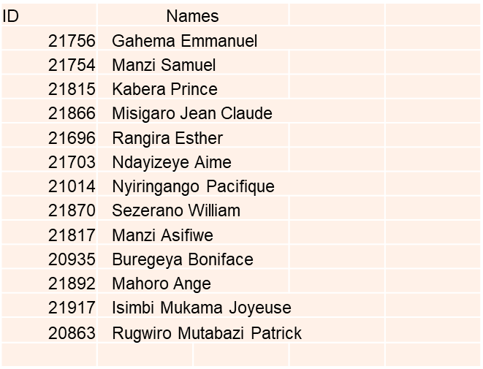
Group three members:

Slide 3
Why o/r mapping needed?
O/R mapping using hibernate has three most important mapping topics.
These are:
Mapping of collections,
Mapping of associations between entity classes, and
Component Mappings.

Slide 4
Collection mappings
If an entity or class has collection of values for a particular variable, then we can map those values using any one of the collection interfaces available in java. Hibernate can persist instances of:
java.util.Map
java.util.Set
java.util.SortedMap
java.util.SortedSet
java.util.List
Java.util.collection and any array of persistent entities or values.
A link that can help learning More on Collection Mappings: https://docs.jboss.org/hibernate/core/3.6/reference/en-US/html/collections.html https://www.javatpoint.com/collection-mapping

Slide 5
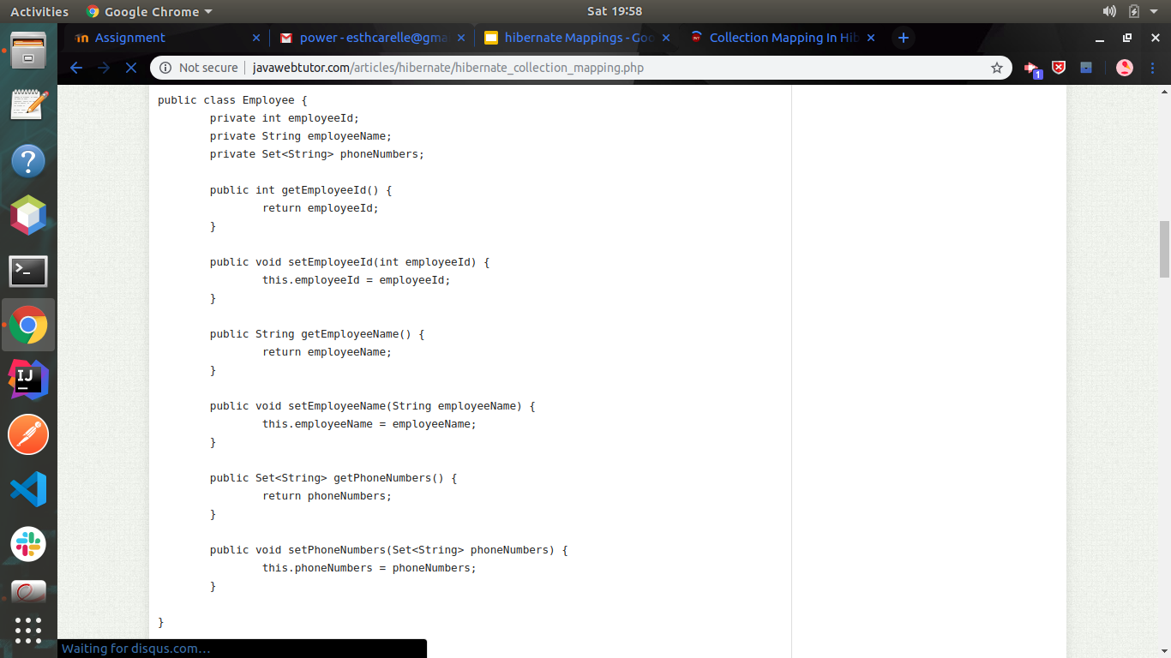
Mapping set
To start with, we will create a class Employee with properties employeeId , employeeName and phoneNumbers .Here we want to store Phones for a Student. There are more than one Phone for a Student so phoneNumbers should be declared as collection type

Slide 6
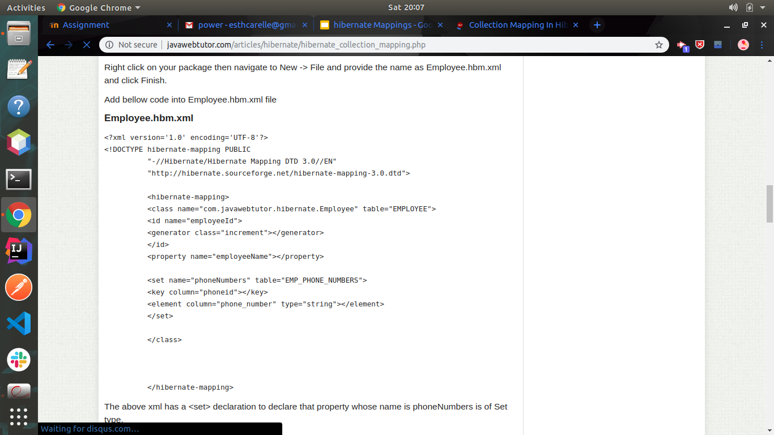
Mapping file
Create the mapping file for Persistent class
This will lead to the creation of another table which will have the phone id as a foreign key from the table Employee

Slide 7
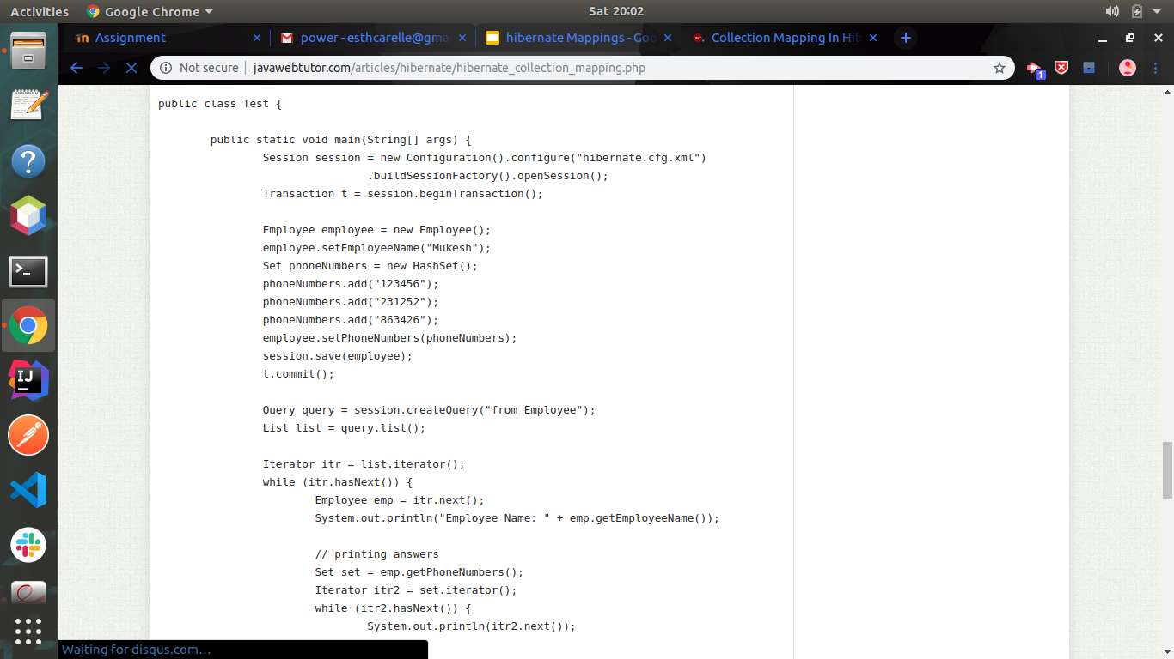
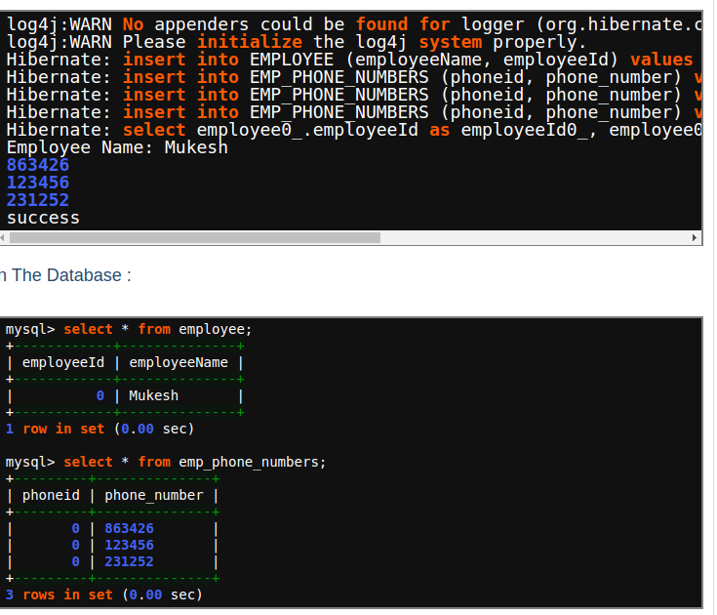
Main class and output

Slide 8
ASSOCIATION MAPPINGS
The mapping of associations between entity classes and the relationships between tables is the soul of ORM. Following are the four ways in which the cardinality of the relationship between the objects can be expressed. An association mapping can be unidirectional as well as bidirectional.
A class must be created with an @Entity annotation. The @Entity annotation is a marker annotation, which is used to discover persistent entities.
One-to-One
One-to-Many
Many-to-One
Many-to-Many

Slide 9
TYPE OF ASSOCIATION AND ITS USAGES:
Before We must know also that association ownership is concerned exclusively with the management of the foreign keys in the database and that’s it.
One-to-one: either end can be made the owner, but one (and only one) of them should be; if you don’t specify this, you will end up with a circular dependency.
One-to-many: the many end must be made the owner of the association.
Many-to-one : This is the same as the one-to-many relationship viewed from the opposite perspective, so the same rule applies: the many end must be made the owner of the association.
Many-to-many: Either end of the association can be made the owner.

Slide 10
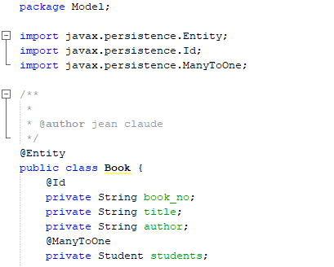
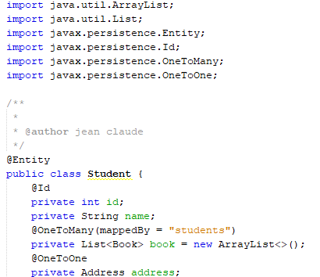
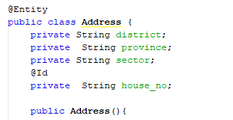
Now to tell hibernate the association is managed by Book Class, we will add “mapped By” attribute inside Student Class to make it manageable. and Book Class is managing the relationship.
Notice:
In hibernate mapping associations, one (and only one) of the participating classes is referred to as “managing the relationship” and other one is called “managed by” using ‘mappedBy’ property. We should not make both ends of association “managing the relationship”.

Slide 11
COMPONENT MAPPINGS
It is very much possible that an Entity class can have a reference to another class as a member variable. If the referred class does not have its own life cycle and completely depends on the life cycle of the owning entity class, then the referred class hence therefore is called as the Component class.
The mapping of Collection of Components is also possible in a similar way just as the mapping of regular Collections with minor configuration differences. We will see these two mappings in detail with examples.
“Mapping for a class having a reference to another class as a member variable”.

Slide 12
Thank you!

